Slide 1
“Hi. My name is Jay and
I’ve hired a lot of faculty at teaching-focused institutions.”
Jay Howard, Butler University
Interim Provost and Executive Vice President
Professor of Sociology

Slide 2

First, look around and ensure your grad advisor is not in the room.

Slide 3



Finding the Best “Fit”
Balance between teaching, scholarship, & service

Slide 4

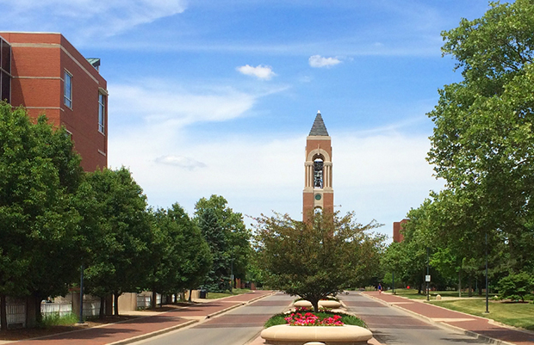

Teaching vs. Research Emphasis
Research 1, Doctoral Institution (IU)
Regional Public Universities (Ball State University)
Regional Campuses State Universities (IU South Bend)
Mid-sized Private Universities (Butler)

Slide 5


Teaching vs. Research Emphasis
Small Liberal Arts Colleges (Saint Mary’s College)
Community Colleges (Sinclair CC)

Slide 6
How Does Emphasis on Teaching Show Up?
Greater Number of Courses Taught Each Semester
Range of Courses Taught
Annual Performance Reviews
Promotion & Tenure Reviews
Expectation to be Student-Centered & Responsive
Available to Students Outside of Class

Slide 7
Scholarship Is Often Expected
3 credit release from teaching for scholarship each semester
Expectations for publication, but not at Research 1 level
Articles, Books, Book Chapters, Public Scholarship, Presentations
Undergraduate involvement in research highly valued

Slide 8

What should you be doing now?
Get a peer reviewed publication
Take teaching seriously
  Teaching matters for 90% of jobs
Get a peer review of your teaching
  Letter of recommendation

Slide 9

What should you be doing now?
Get experience as instructor of record
  Prefer not to hire someone for whom all courses are new preps

Slide 10

What should you be doing now?
Center for Innovative Teaching & Learning Graduate Teaching Apprenticeship Program
Document on CV

Slide 11


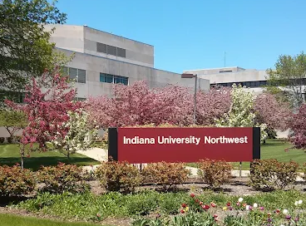
What should you be doing now?
Take a For-Credit Pedagogy Course
Participate in IU Future Faculty Teaching Fellows (FFTF) Program
  Year @ IU Regional Campus or Butler University as half-time faculty.

Slide 12
Where Do I Look for Job Openings?
Discipline specific listings
Chronicle of Higher Education
  3010 Social & Behavioral Science faculty jobs listed (1/14/2026)
Higher Ed Jobs
  Over 7,772 jobs listed in “Liberal Arts” includes both social sciences and humanities (1/14/2026)

Slide 13
4 Stages of the Job Search Process
Application: Cover Letter & CV
Zoom Interview
Campus Interview
Offer & Negotiation

Slide 14

Tailor Cover Letters
Why do you want to be here specifically?
Cite institution and department mission
Clearly address how you meet areas of specialization
Teaching first or Research first?

Slide 15
Curriculum Vitae
Degrees & Expected Degree Dates
Publications, Grants, etc.
Talks, Presentations
Teaching Experience
Fellowships & Awards
Professional Development
  Pedagogy Workshops
  Teaching Certificates
Service Roles

Slide 16
Congratulations! You’ve been selected for a Zoom Interview
Do your homework
  Know size/enrollment
  Know degree of selectivity
  Know percent female, people of color, first generation, etc.
Ask about length of interview and number of questions
Be careful about social media
  Restrict to friends
  Avoid inflammatory statements

Slide 17

Congratulations, Again! You’re Getting a Campus Interview
Ask about presentation expectations
  Topic: Research? Teaching? Both?
  Audience composition and size
  Length? Q&A?
Everyone you meet matters
  Staff
  Students
Being interviewed from moment plane lands

Slide 18

Campus Interview
Don’t come across as “entitled”
  I only want to teach Tues & Thurs…
  I don’t want to prep more than 3 courses pre-tenure
Be interested in campus and people
  Google people you will meet/Dig into website
  Butler’s Psychology Department:
    Undergraduates in research
    High percentage go on to graduate study

Slide 19

Congratulations!
You Got a Job Offer
Don’t Accept on Spot
Negotiate Nicely (over phone)
Search Chair Is Your Ally
  Anything I should be asking for?
  Research Startup $, Moving Expenses, Summer Salary?
Don’t Communicate You View Faculty Role as an “Independent Contractor”

Slide 20
Market Stinks in Many Disciplines
Remember Teaching Matters!
Institutions want to hire those that want scholarship vs. teaching balance that they offer
No one wants to hire “Independent Contractor” faculty
Communicate you want to be part of something bigger than yourself

Slide 21
“Hi. My name is Jay and
I’ve hired a lot of faculty at teaching-focused institutions.”
Jay Howard, Butler University
Interim Provost and Executive Vice President
Professor of Sociology

